Slide 1

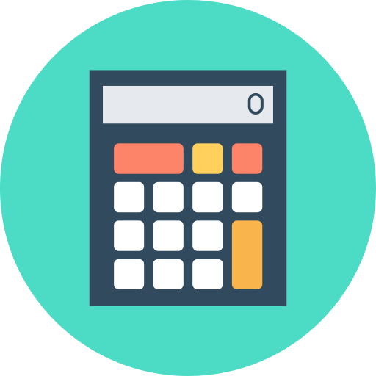

Presentation On “CALVERTER”
Convert
Calculate
A project By: Code Warriors

Slide 2
Submitted To
Bijan Paul
Lecturer
Department of Computer Science and Engineering, ULAB
Submitted By
Mahfuza Akhter Lima 181014016
Md. Mehedi Hasan 181014077
Simron Mhejabin 181014115
Department of Computer Science and Engineering, ULAB
Course Code: CSE 103 Section: 01 Dated: 11/09/2018

Slide 3
Here you will get:
Currency Convert
Time Convert
Concept & Coded By: Mehedi 181014077
Converter
Concept & Coded By: Mehedi 181014077
Concept & Coded By: Simron 181014115
Age Calculator
Analyzer
BMI Calculator
Calculator
Concept & Coded By: Mehedi 181014077
Concept & Coded By: Lima 181014116

Slide 4
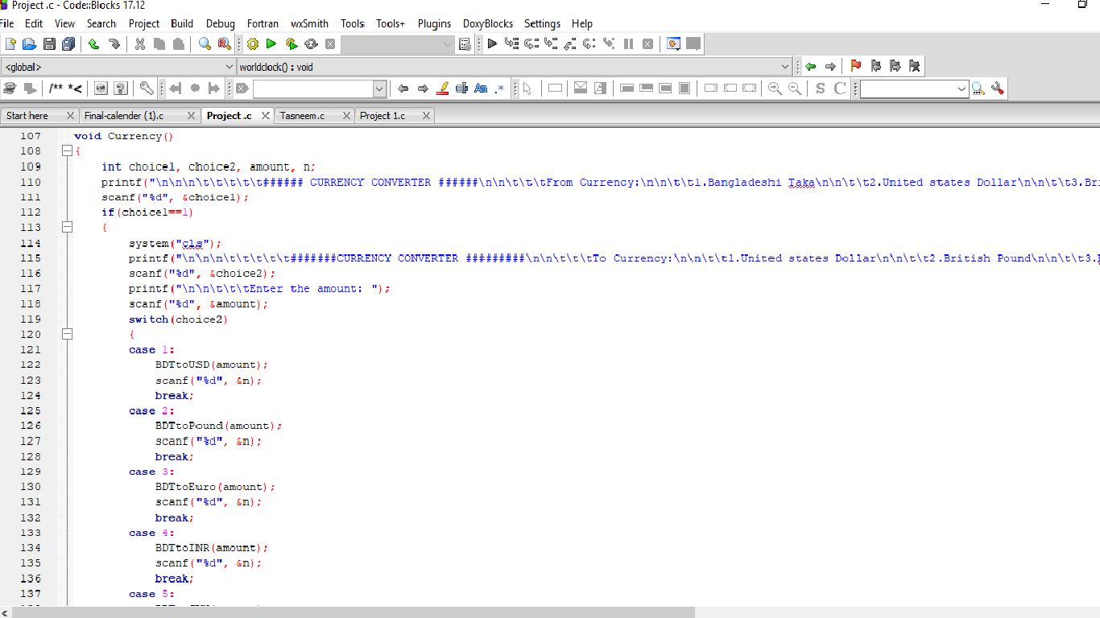
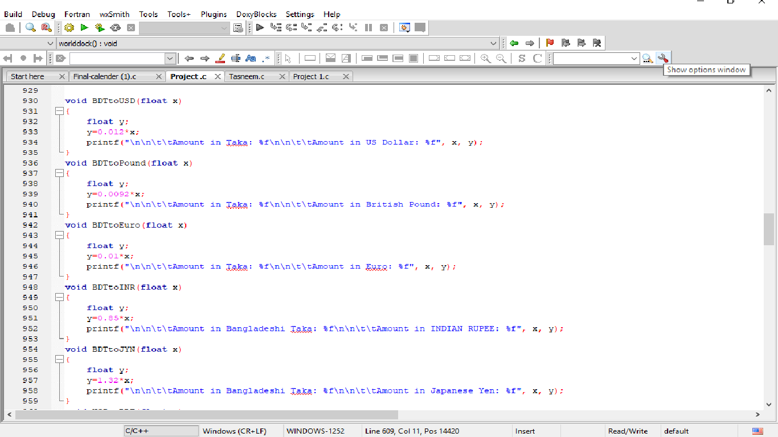
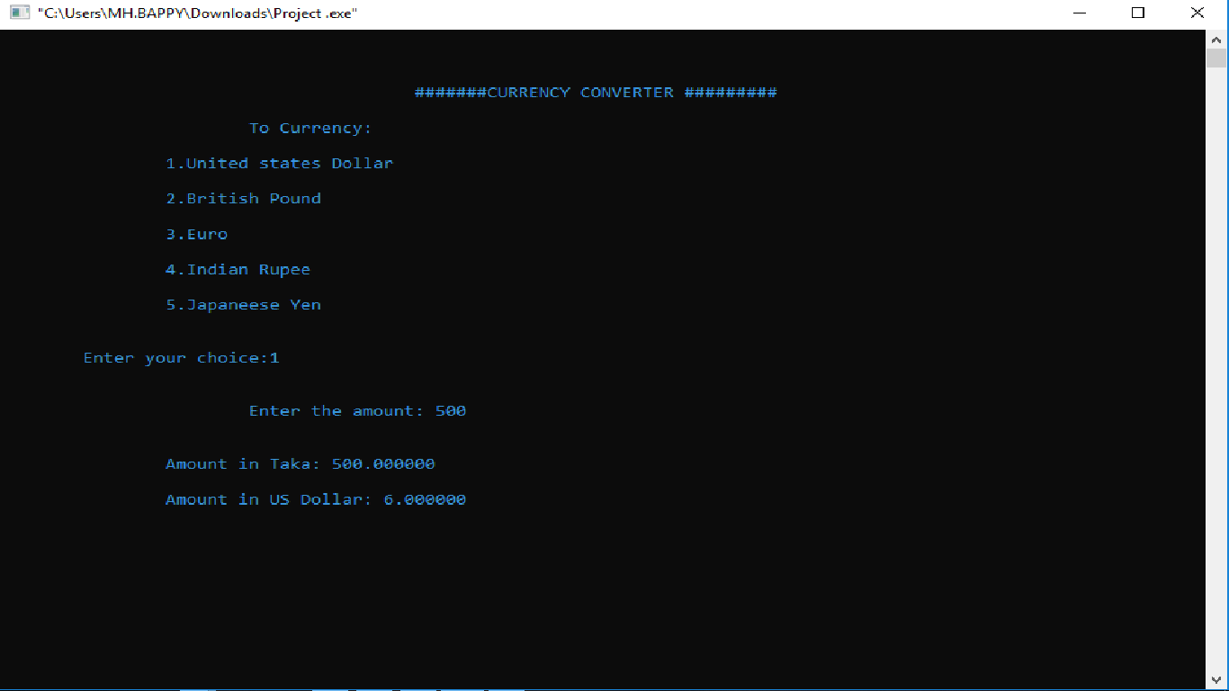
Currency Convert

Slide 5
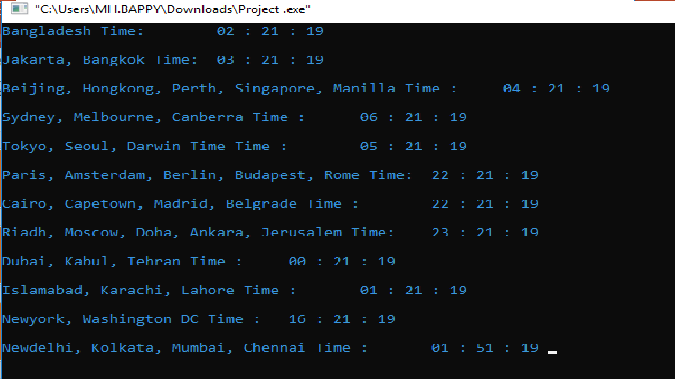
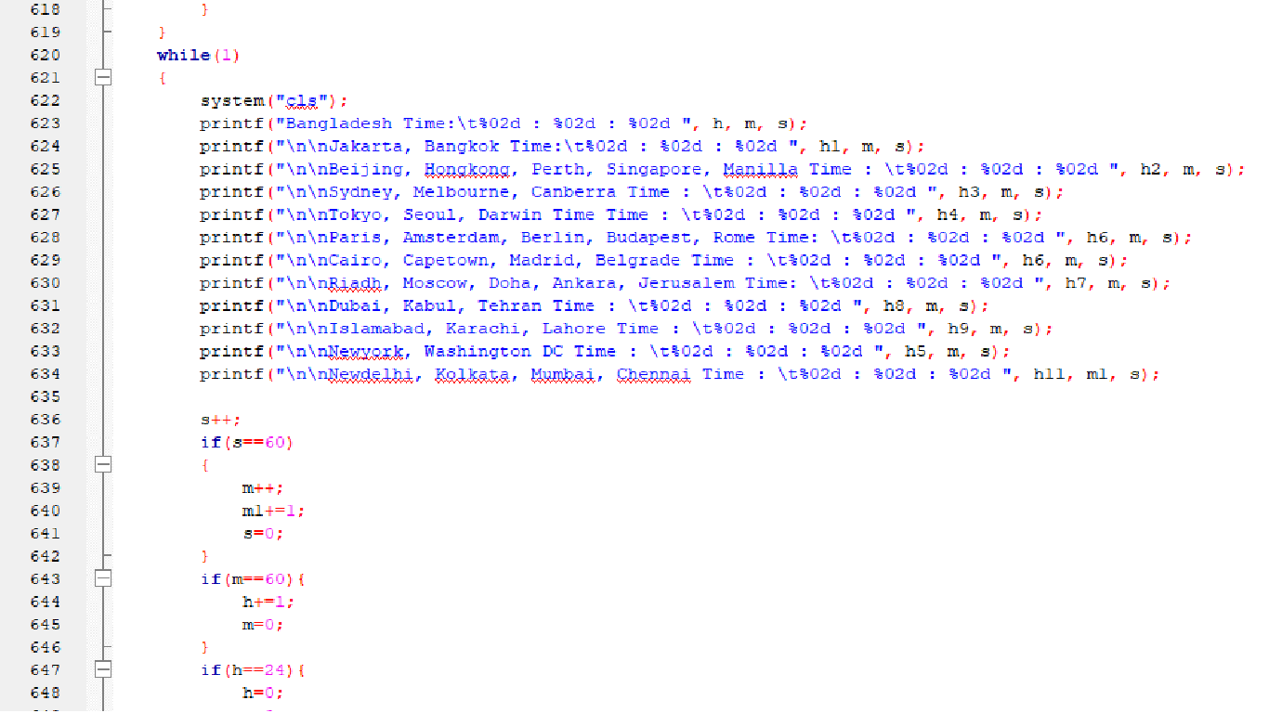
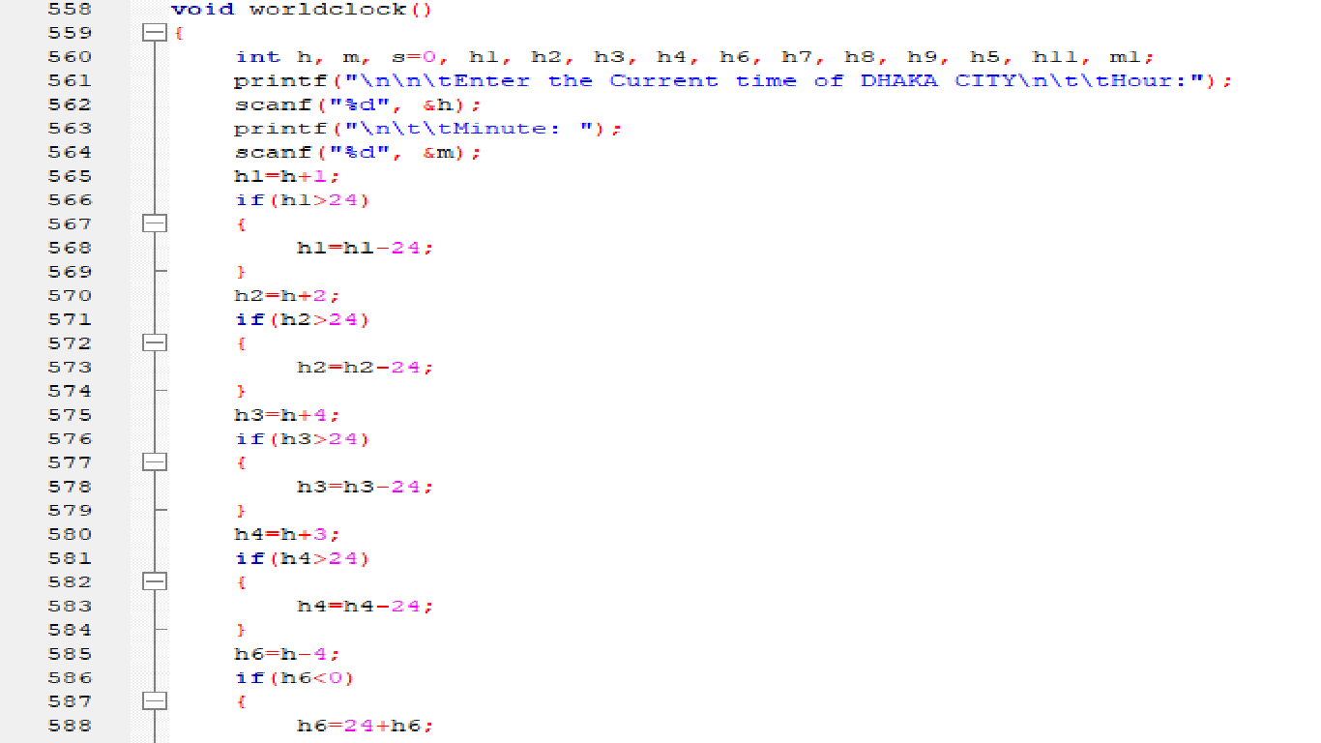
Time Converter

Slide 6
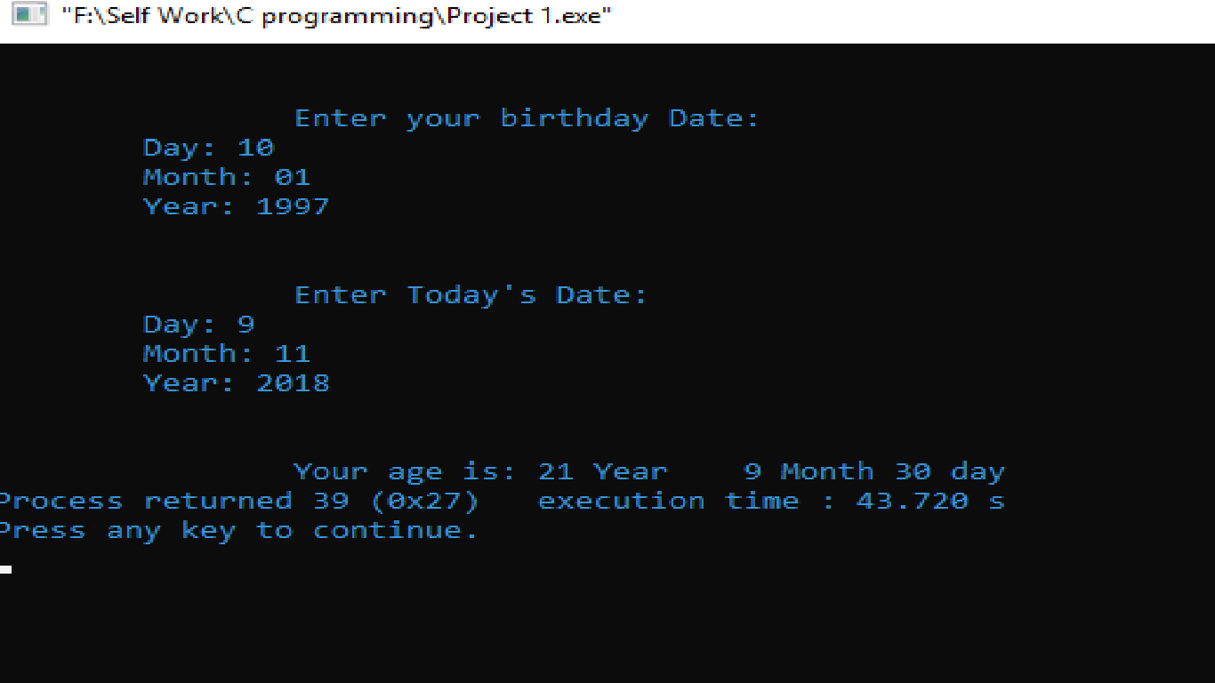
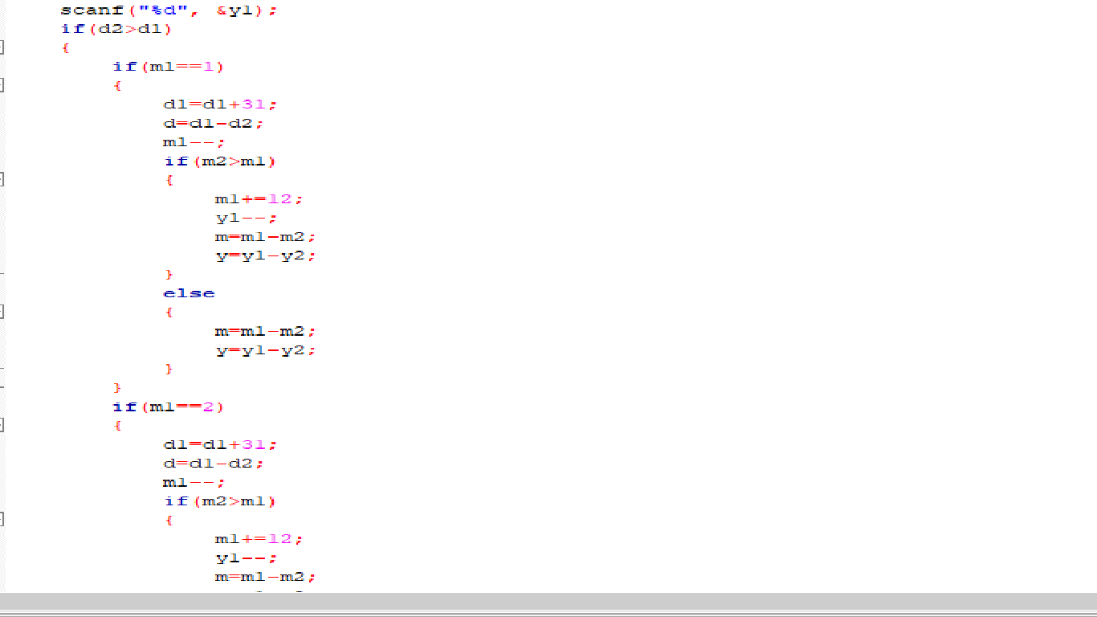
Age Calculator

Slide 7
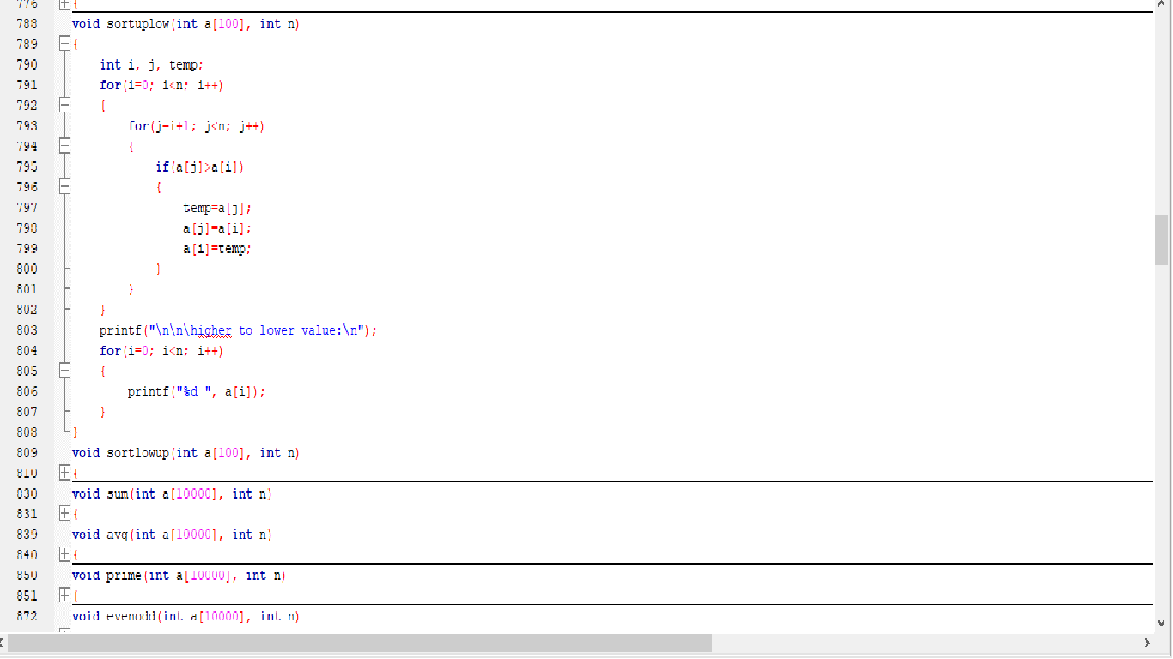
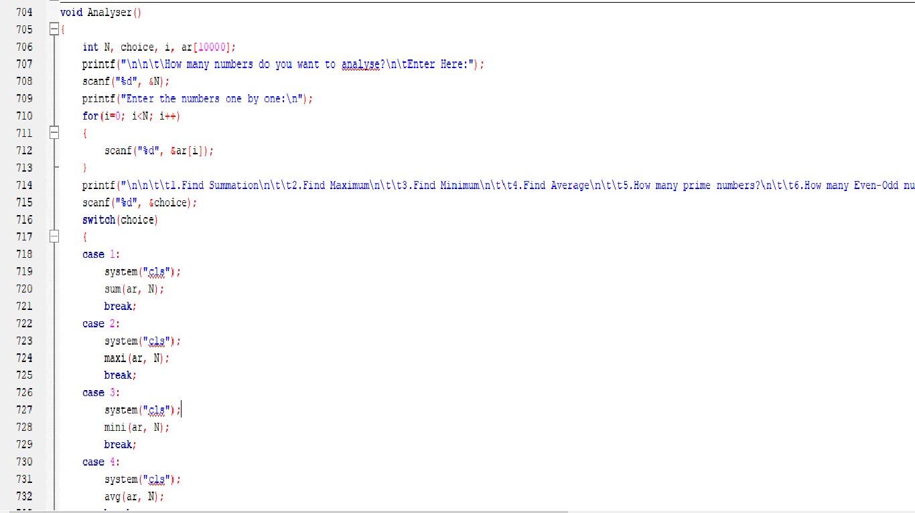
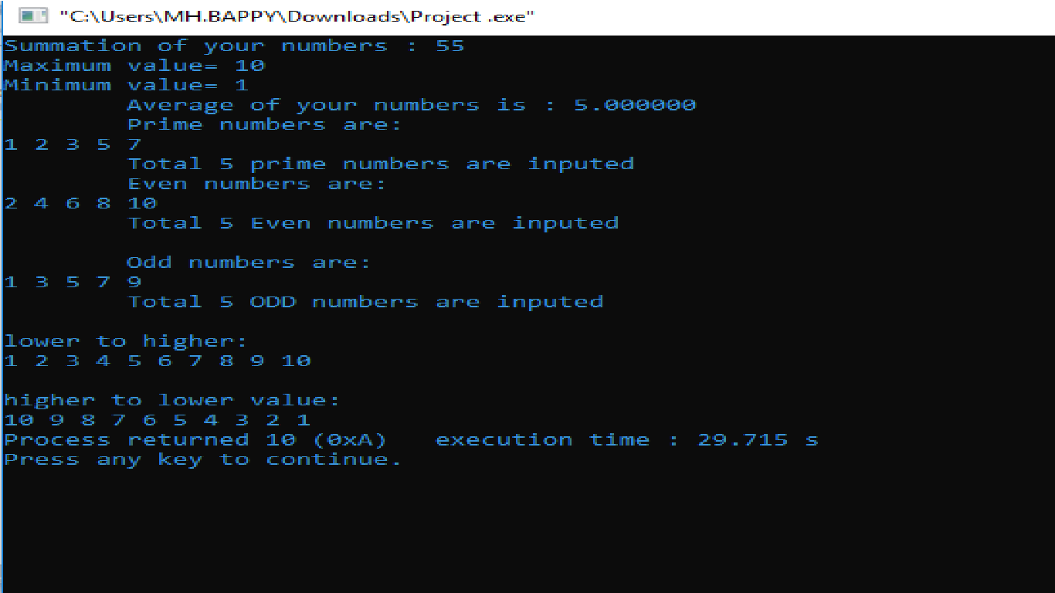
Analyzer

Slide 8
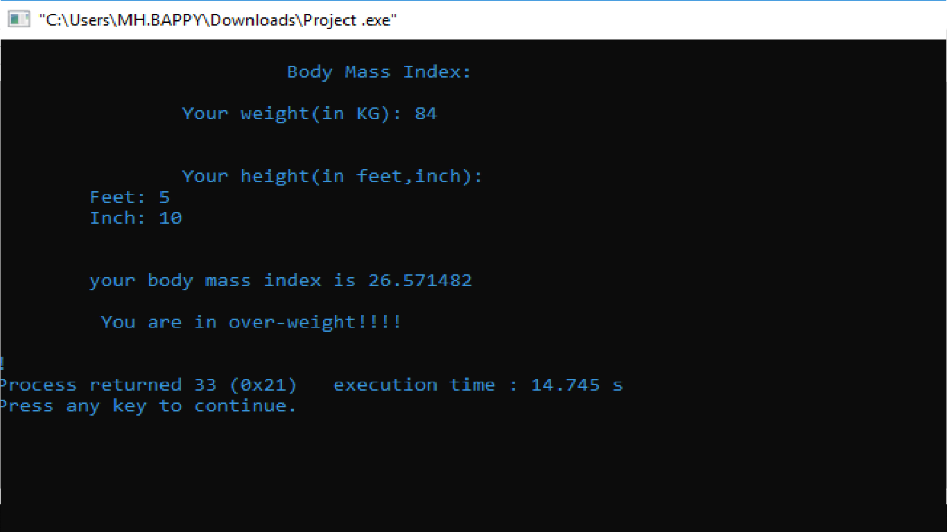
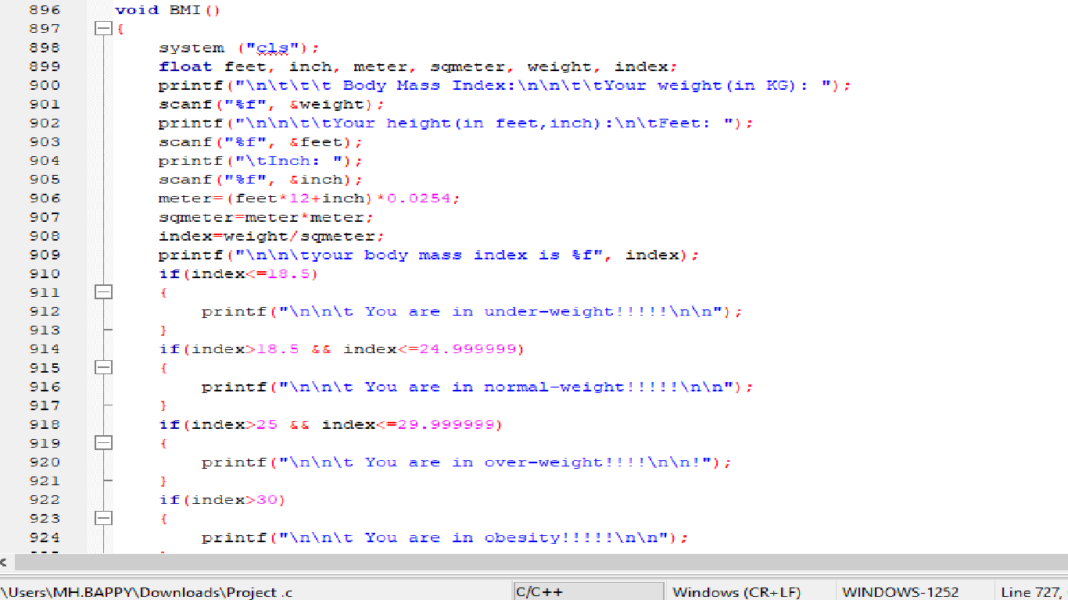
Body Mass Index

Slide 9
Any Question?

Slide 10
Thank You

